Slide 1

Z4 parafermions in time-reversal invariant topological insulators
Thomas Schmidt
in collaboration with:
Christoph Orth, Rakesh Tiwari (Uni Basel)
Tobias Meng (TU Dresden)

Slide 2
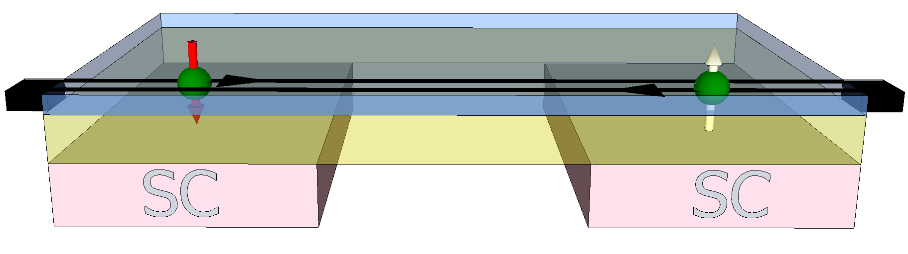
Outline
Helical edge states of 2D topological insulators
Interactions in helical systems
Interface bound states due to the superconducting proximity effect
Conclusions

Slide 3
Outline
Helical edge states of 2D topological insulators
Interactions in helical systems
Interface bound states due to the superconducting proximity effect
Conclusions

Slide 4
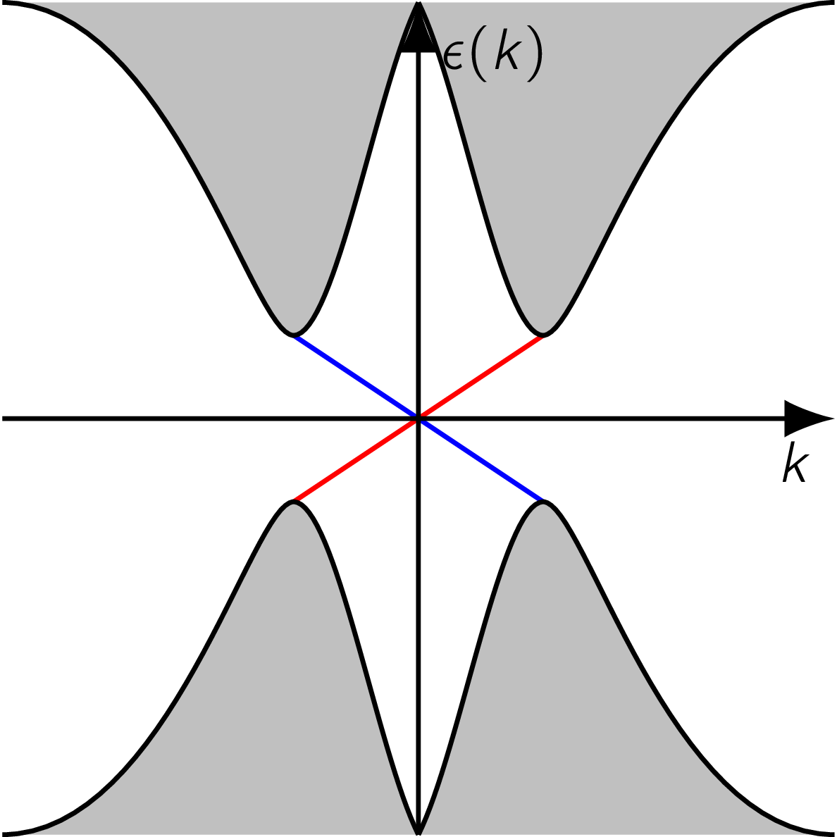
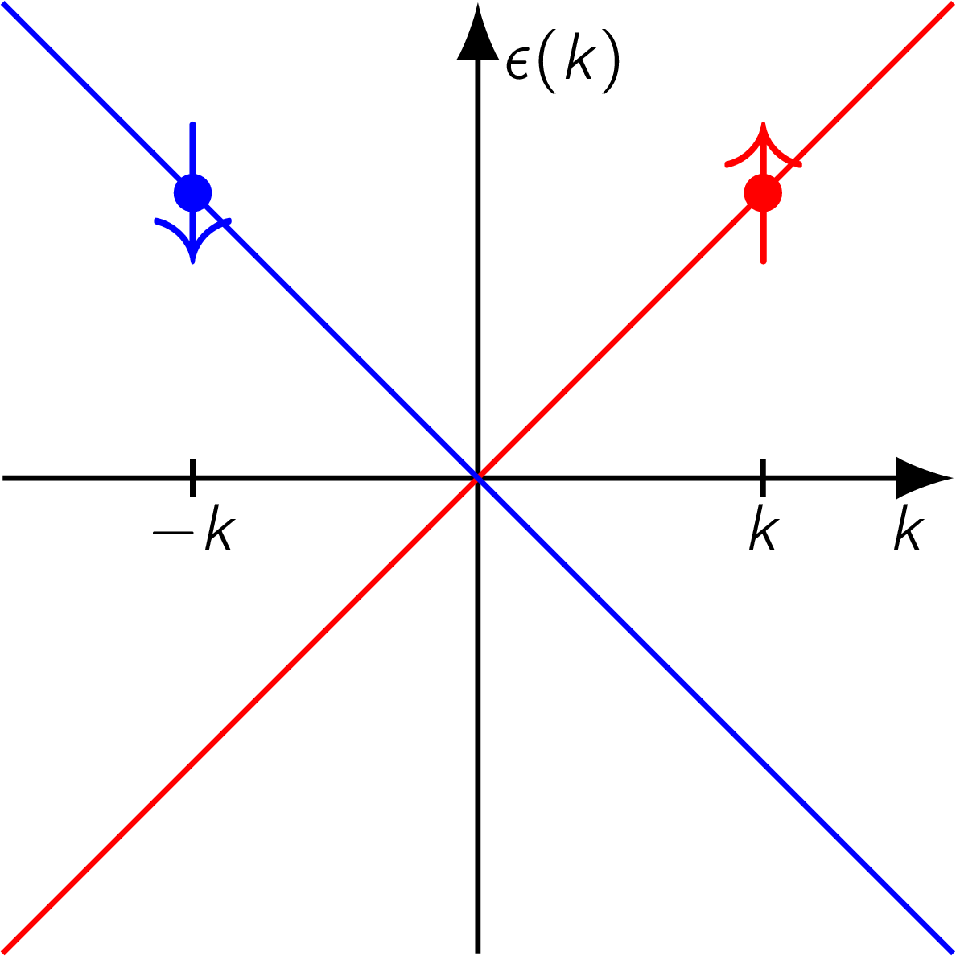
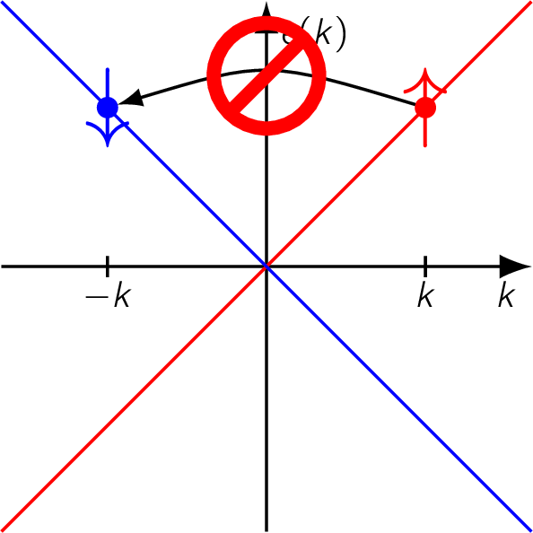



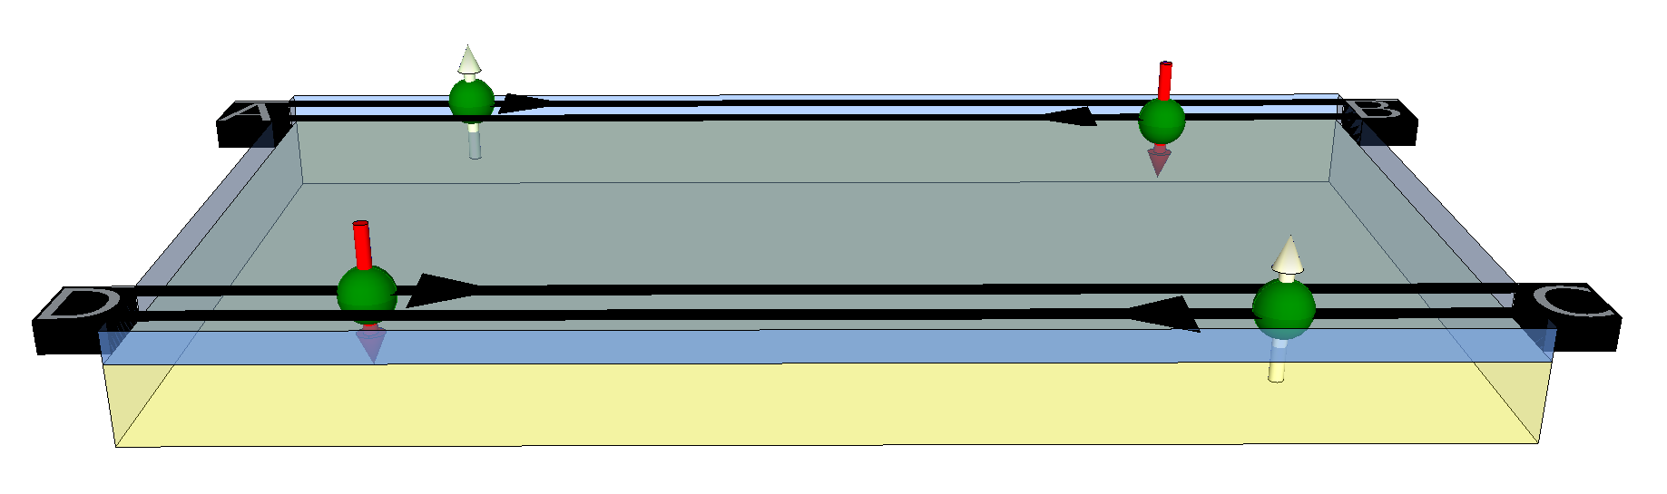
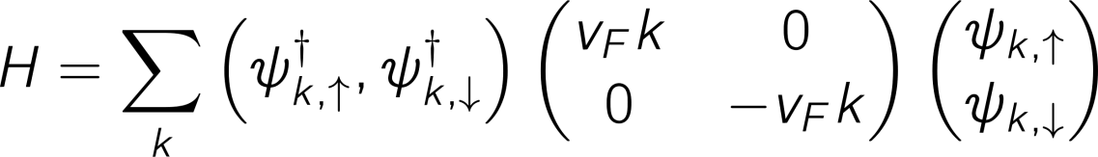
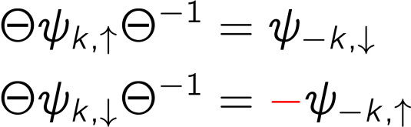
Time-reversal symmetry
2D topological insulators:
Insulating bulk
Metallic 1D edge states
Edge states are helical
Time-reversal operator:
Anti-unitarity:
Spin-1/2 fermions:
Time-reversal of the edge state Hamiltonian:
TRS Hamiltonians cannot couple left-movers and right-movers.
Edge states remain gapless!

Slide 5

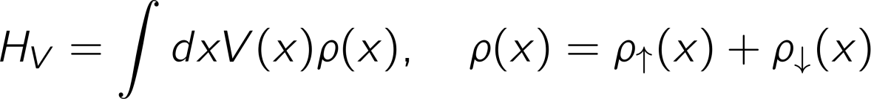
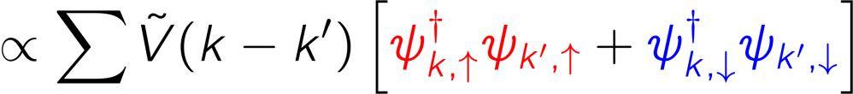


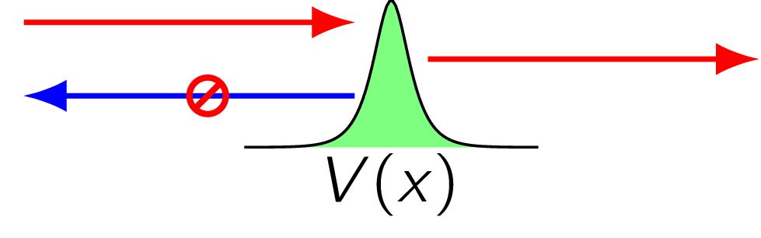
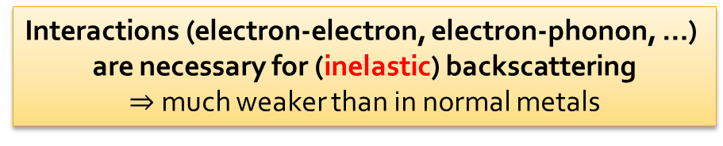
Impurities and interactions
Impurity scattering:
Potential on the edge:
Only forward scattering
Backscattering not TR invariant:
No backscattering: Quantized conductance
Even in the presence of disorder
Even at finite temperature
Interactions (electron-electron, electron-phonon, …)
are necessary for (inelastic) backscattering
$⇒$ much weaker than in normal metals

Slide 6
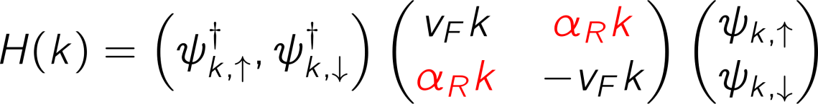
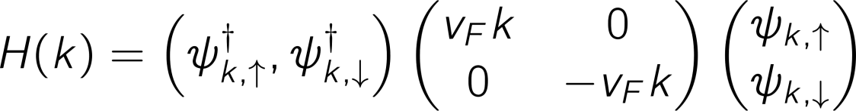
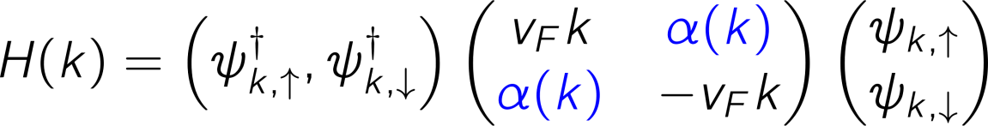



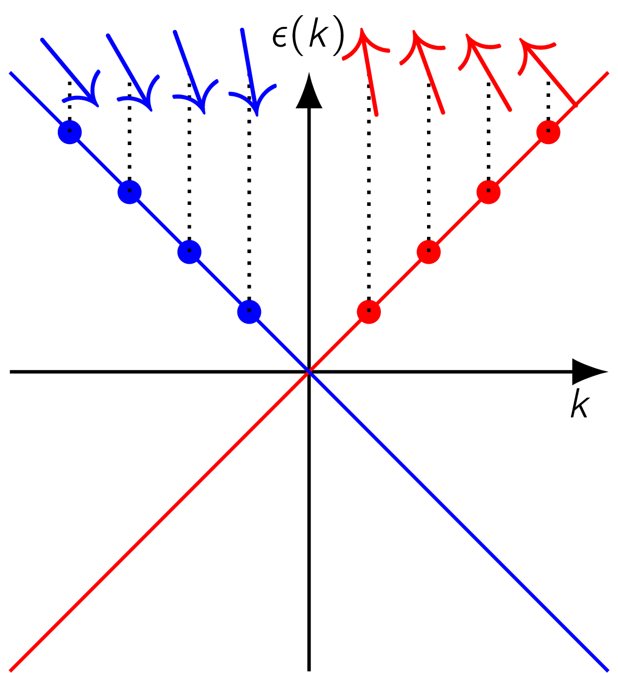
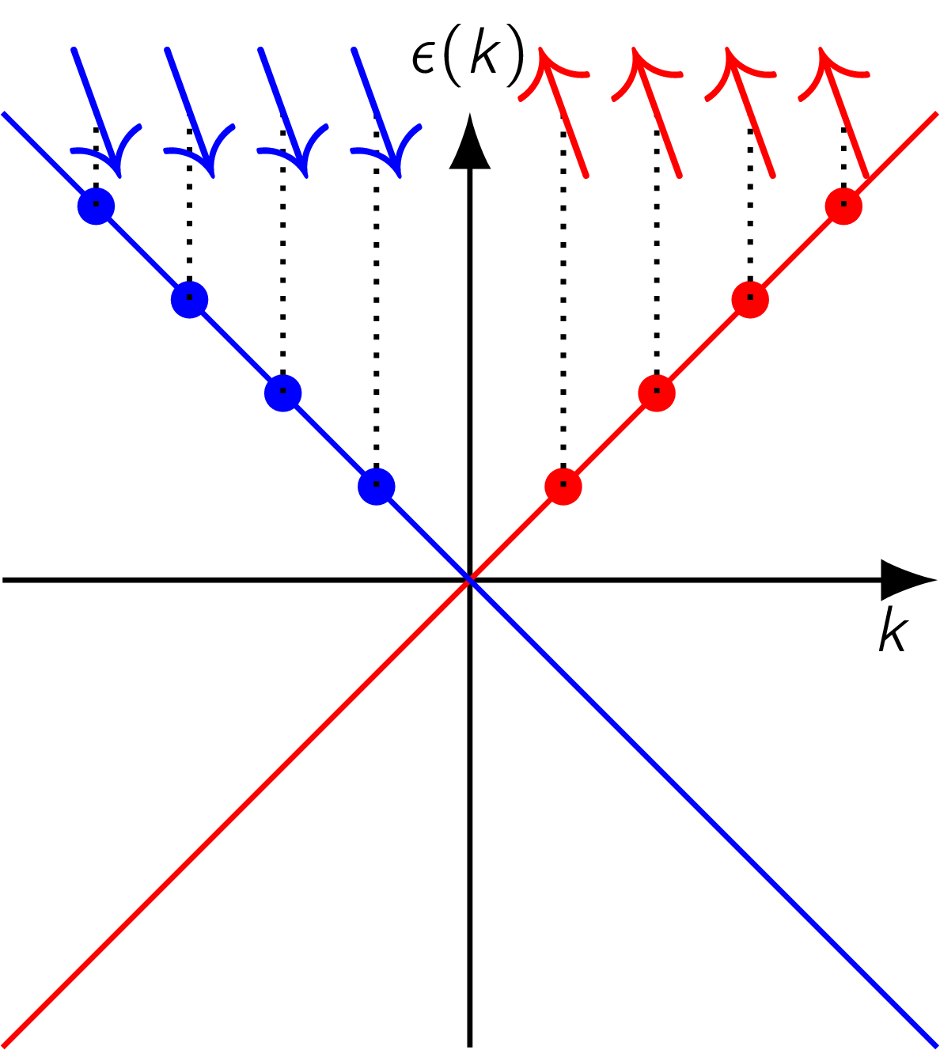
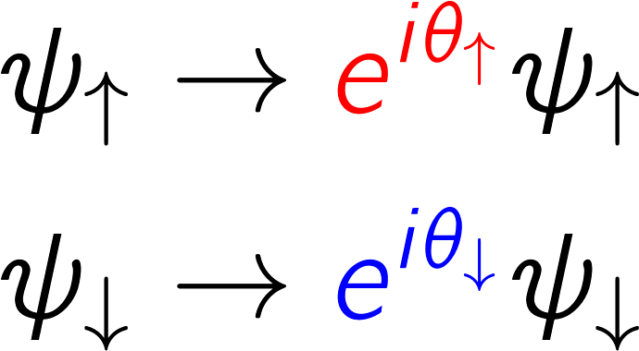
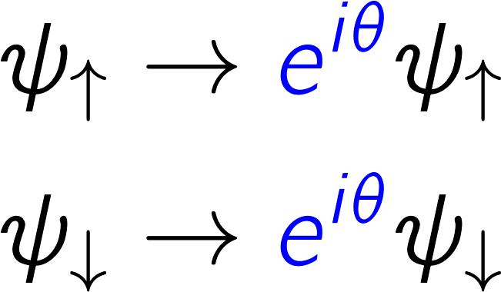
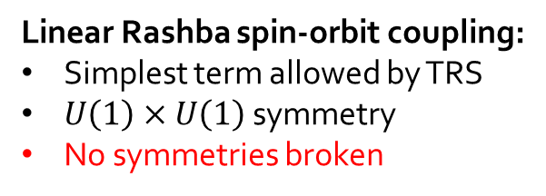
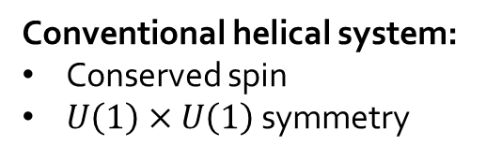
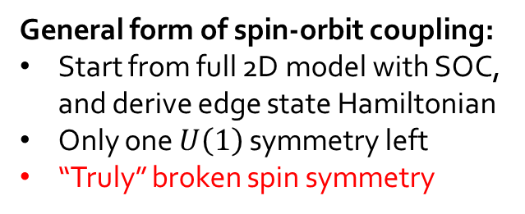
Generic helical systems
What is the most
general edge state Hamiltonian allowed by TRS?
Conventional helical system:
Conserved spin
$U\left(1\right)×U\left(1\right)$ symmetry
Linear Rashba spin-orbit coupling:
Simplest term allowed by TRS
$U\left(1\right)×U\left(1\right)$ symmetry
No symmetries broken
General form of spin-orbit coupling:
Start from full 2D model with SOC, and derive edge state Hamiltonian
Only one $U\left(1\right)$ symmetry left
“Truly” broken spin symmetry

Slide 7
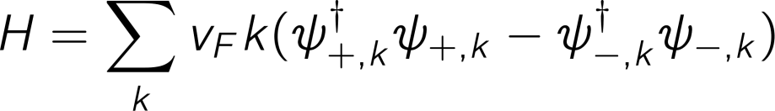
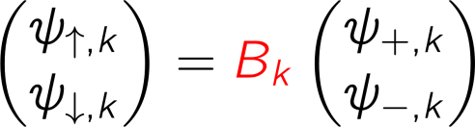

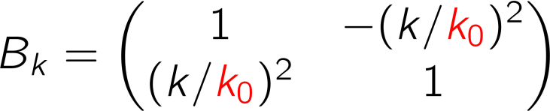
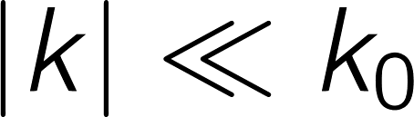

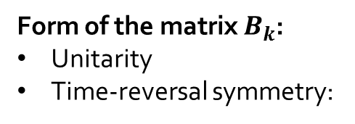
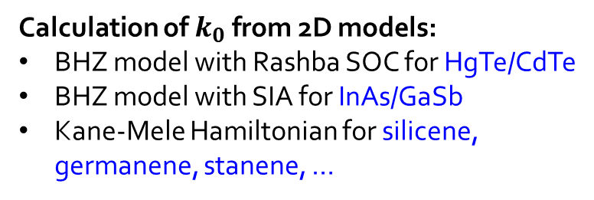
Generic helical systems
Generic 1D edge Hamiltonian:
Form of the matrix $B_{k}$:
Unitarity
Time-reversal symmetry:
Universality at low energies:
Single parameter $k_{0}$
Calculation of $k_{0}$ from 2D models:
BHZ model with Rashba SOC for HgTe/CdTe
BHZ model with SIA for InAs/GaSb
Kane-Mele Hamiltonian for silicene, germanene, stanene, …
Experimental signatures:
Edge conductance at finite temperature
Interedge tunneling in narrow TI ribbons
Spin-resolved STM measurements
Schmidt et al., PRL 108, 156402 (2012)
Orth et al., PRB 88, 165315 (2013)
Kainaris et al., PRB 90, 075118 (2014)
Rod et al., arXiv:1503.03664 (2015)

Slide 8
Outline
Helical edge states of 2D topological insulators
Interactions in helical systems
Interface bound states due to the superconducting proximity effect
Conclusions

Slide 9

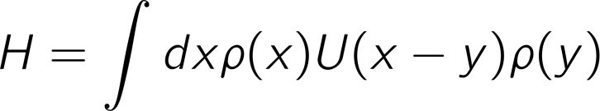
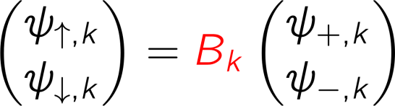
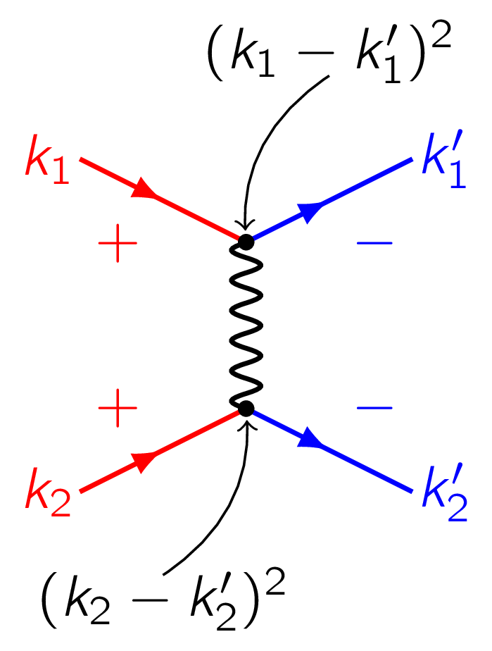
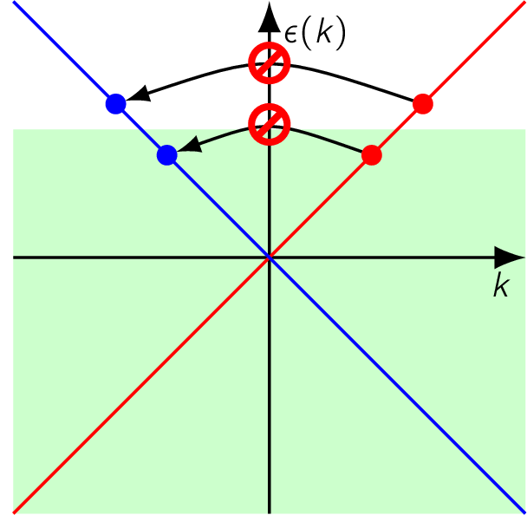
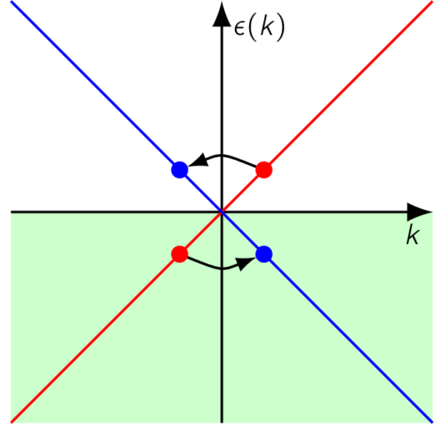
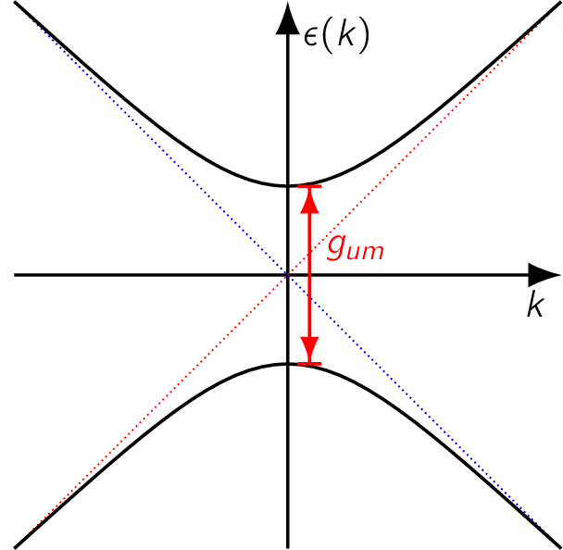
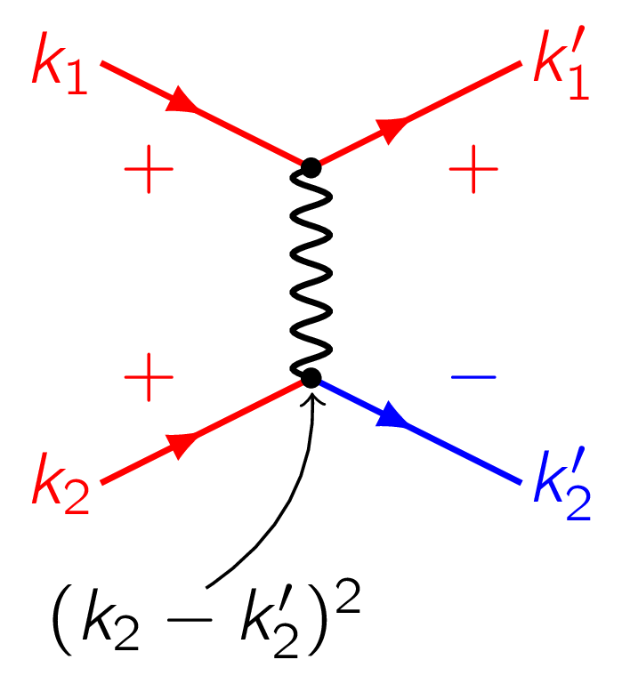




Interactions in helical systems
Electron-electron interactions:
Weakly screened Coulomb interactions
Resulting types of interactions:
“Density-density” interactions
Single-particle backscattering
Two-particle (“umklapp”) backscattering
Can this term open a gap in the edge state spectrum at the Dirac point?

Slide 10
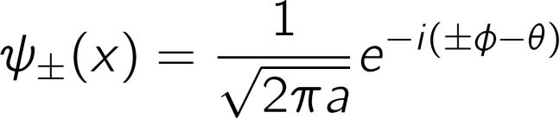
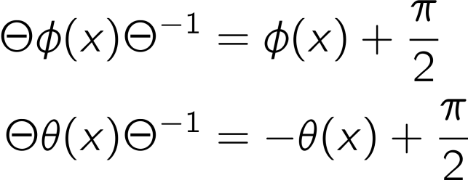
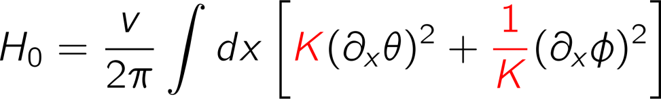
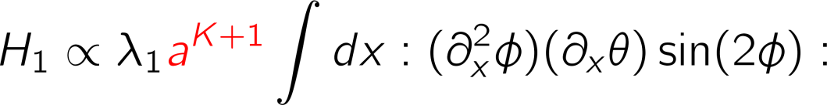
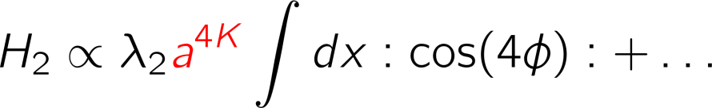



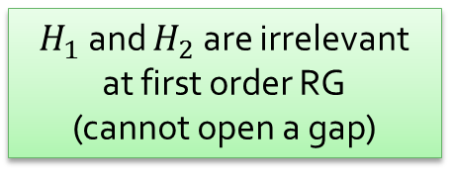
RG using bosonization
Can interactions open a gap in the spectrum?
Bosonization identity:
Bosonic fields $φ\left(x\right)$ and $θ\left(x\right)$
Short distance cutoff $a$
Time-reversal for bosonic operators:
Luttinger parameter $0<K≤1$
Bosonized Hamiltonian:
$H_{1}$ and $H_{2}$ are irrelevant at first order RG
(cannot open a gap)
$H_{1}$ is dangerously irrelevant!

Slide 11
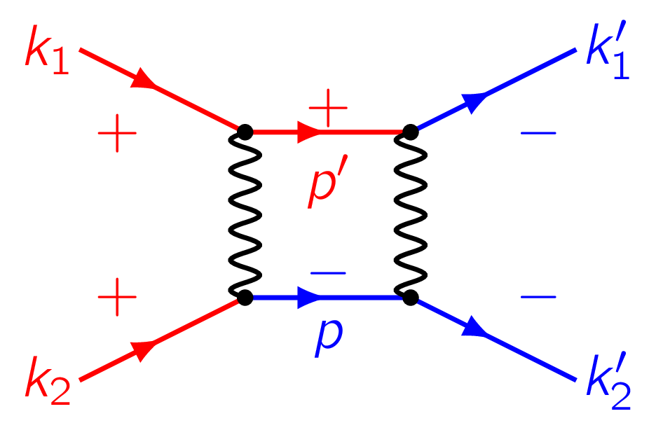
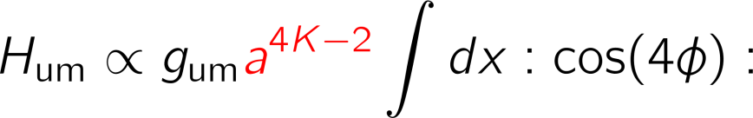
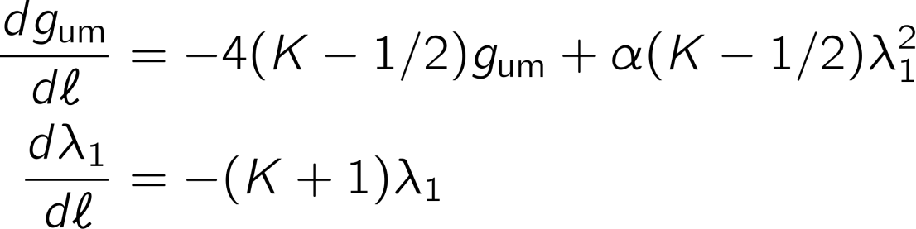
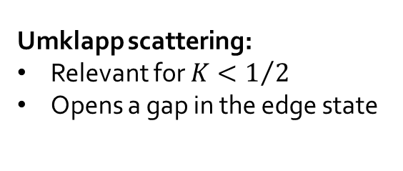
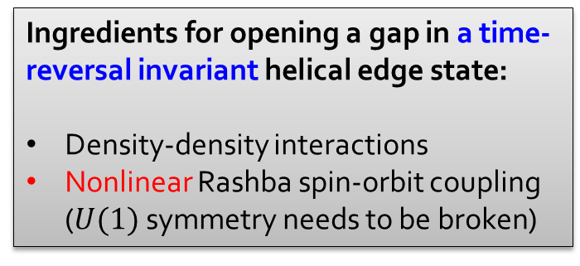


2nd order RG
Single-particle backscattering:
2nd order in $λ_{1}$:
A new term is generated during the RG flow of $λ_{1}$:
Complete RG equations:
Ingredients for opening a gap in a time-reversal invariant helical edge state:
Density-density interactions
Nonlinear Rashba spin-orbit coupling ($U(1)$ symmetry needs to be broken)
Umklapp scattering:
Relevant for $K<1/2$
Opens a gap in the edge state

Slide 12
Outline
Helical edge states of 2D topological insulators
Interactions in helical systems
Interface bound states due to the superconducting proximity effect
Conclusions

Slide 13
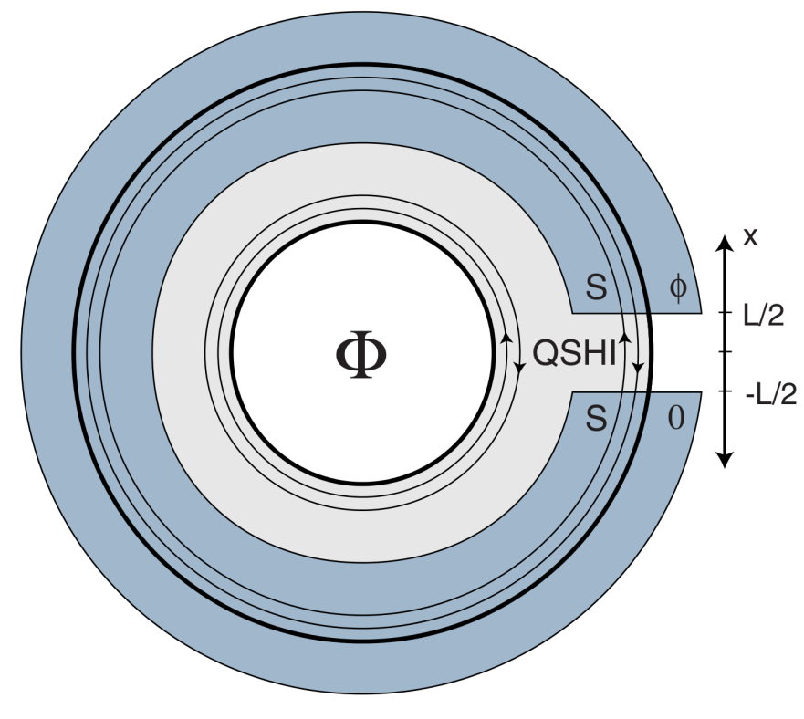



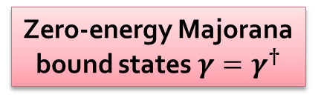
Interface bound states
Spectral gaps in (non-interacting) helical edge states:
Superconductivity:
Preserves time-reversal symmetry
Conserves spin symmetry
Gap is topologically nontrivial
Magnetic field:
Breaks time-reversal symmetry
Breaks spin symmetry
Gap is topologically trivial
Umklapp scattering:
Preserves time-reversal symmetry
Breaks spin symmetry
Gap is topologically trivial
Zero-energy Majorana bound states $γ=γ^{†}$
What is the nature of these bound states?
Fu and Kane, PRB 79, 161408 (2009)

Slide 14
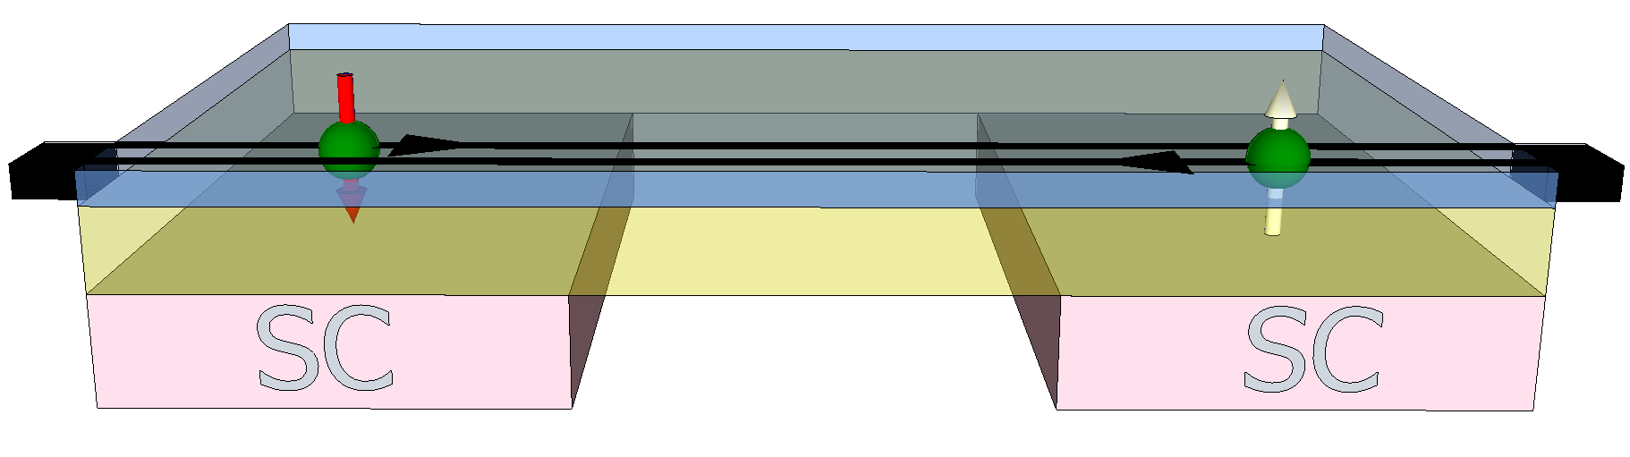
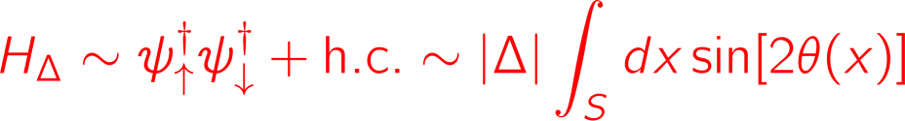






Single junction
Interface bound states:
Chemical potential at Dirac point ($k_{F}=0$)
Region gapped by superconducting proximity effect ($K>1/2$)
“Mott insulating” regions gapped by interactions ($K<1/2$)
Mean-field approximation
Superconductor pins $θ$: $θ\left(x\right)≈−π/4$ for $x∈S$
“Mott insulator” pins $φ$: $φ\left(x\right)≈π/4$ for $x∈M$
But $\left[φ\left(x\right), θ\left(y\right)\right]≠0$
Zero-energy fermionic modes:

Slide 15







Ground state degeneracy
$2N$ sections and periodic b.c.:
$N$ Mott insulating regions conserve:
charge, spin parity (mod 4)
$N$ superconducting regions conserve:
charge parity (mod 2), spin
Conserved quantum numbers:
Ground states:
Degeneracy: $4^{N}×2$
For $N=1$: 8-fold degenerate
Lindner et al., PRX 2, 041002 (2012)

Slide 16







Interface quasiparticles
Bound state charge:
Quantized in units of e/2
(similar to Jackiw-Rebbi and Su-Schrieffer-Heeger model)
Raising/lowering operators:
Increase charge in
region j by 1/2:
Increase spin in
region j by 1:
Local interface operators:
act within ground state subspace
$ℤ_{4}$ parafermion algebra:
Experimental signatures:
$8π$ periodic Josephson effect
Non-Abelian braiding statistics
Zhang and Kane, PRL 113, 036401 (2014)
Orth et al. PRB 91, 081406(R) (2015)

Slide 17








Braiding
2D p-wave superconductors:
Vortices pin Majorana bound states
Ground state degeneracy
Order parameter changes by $2π$
Braiding:
Adiabatic exchange of two vortices produces a nontrivial transformation within the degenerate ground state subspace
Can we do something similar with the parafermions in our 1D edge states?
Non-Abelian exchange statistics
Ivanov, PRL 86, 268 (2001)

Slide 18






Fusing bound states
Problem:
Our edge states cannot be moved in two dimensions because they live on the edge!
Moving states by fusing:
Nucleate a new pair of bound states
Fuse with existing bound state
Transfer of quantum state

Slide 19












Braiding
Braiding:
“Braiding by fusion”
Feasible using tunable proximity
effect and gate voltages
Representation of the braid group:
Yang-Baxter equations

Slide 20

Conclusions
Strong interactions can open a gap in a time-reversal invariant 2D topological insulator but nonlinear spin-orbit coupling is necessary
Zero-energy bound states exist at interfaces with superconducting regions
Bound states obey non-Abelian $ℤ_{4}$ exchange statistics
C.P.Orth, R.P. Tiwari, T.Meng, and T.L.Schmidt, Phys. Rev. B, 2015, 91, 081406(R)

