Slide 1

Coexisting Edge States and Gapless Bulk in Topological States of Matter
Y. Baum, T. Posske, I. C. Fulga,
B. Trauzettel, A. Stern
Phys. Rev. Lett. 114, 136801
arXiv:1503.04845

Slide 2
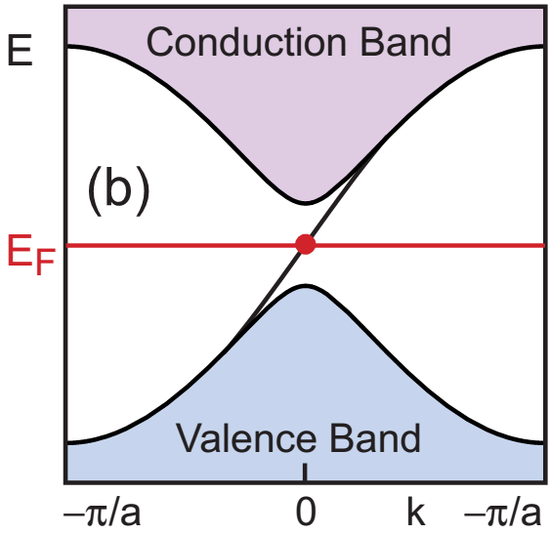
Topological Insulators
Edge states:
Chiral/Helical
Protected by the gap (disorder, local perturbations)

Slide 3
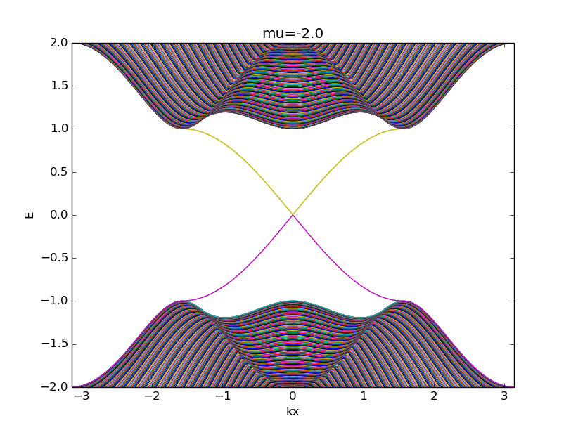
Coexisting Bulk and Edge
Close the gap…

Slide 4
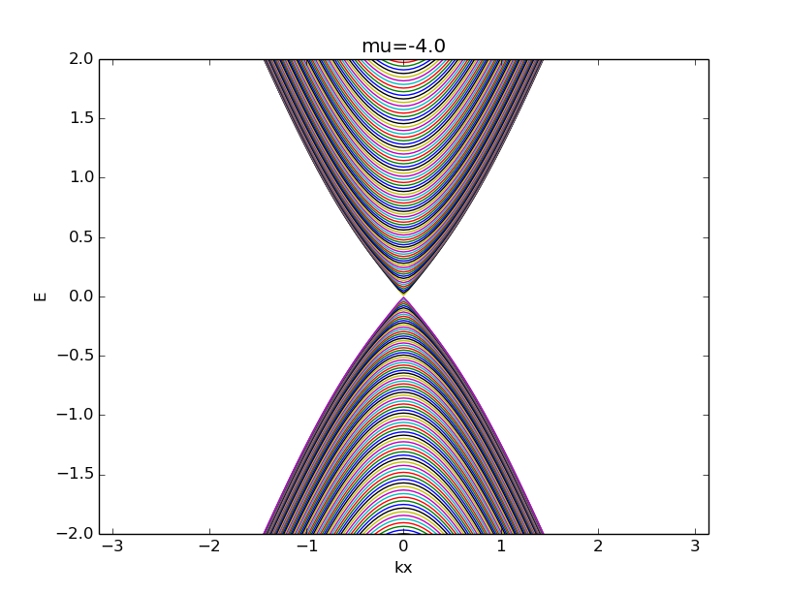
Coexisting Bulk and Edge

Slide 5
Coexisting Bulk and Edge
Solutions?

Slide 6
Coexisting Bulk and Edge
Solutions?
1) More complicated H

Slide 7
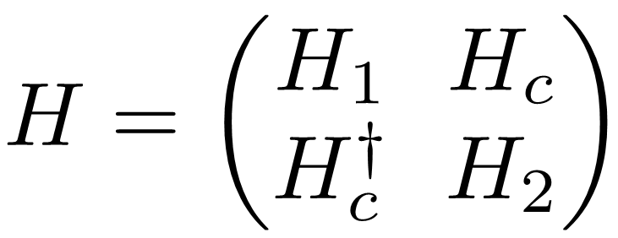
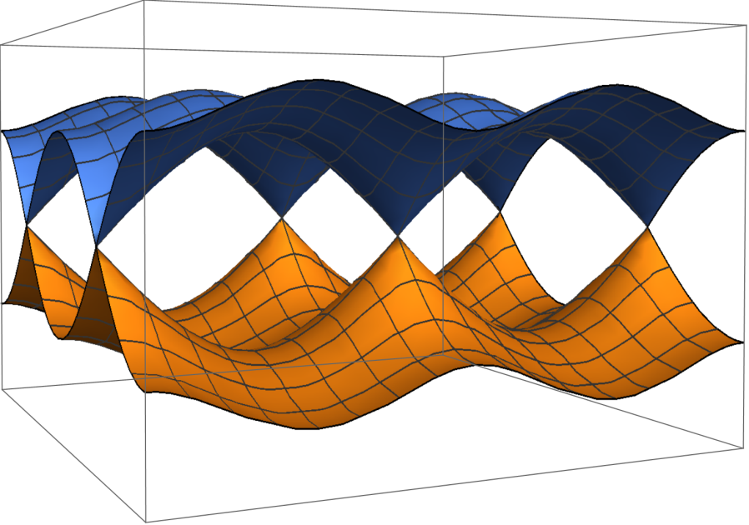
Coexisting Bulk and Edge
Solutions?
1) More complicated H
2) Bilayer

Slide 8
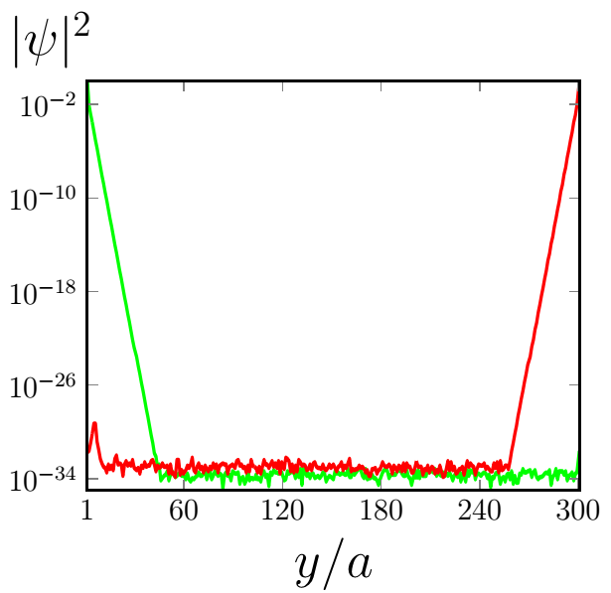
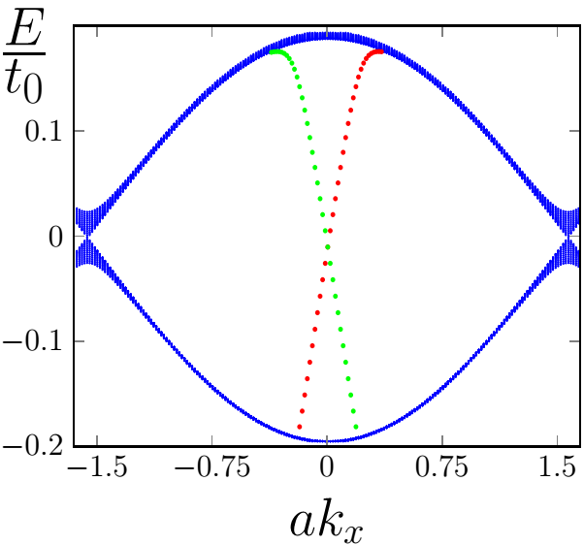
Bilayers: gapless bulk + edges
No disorder:
Different Energies
Different Momenta

Slide 9
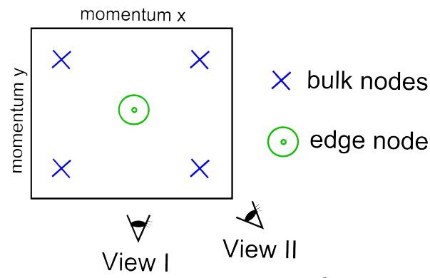
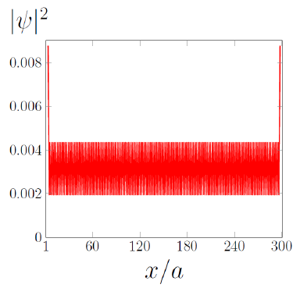
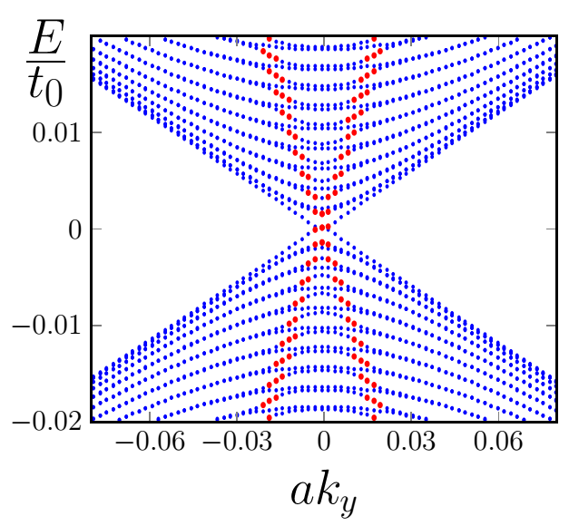
Termination dependent
“Strong” edge
“Weak” edge

Slide 10
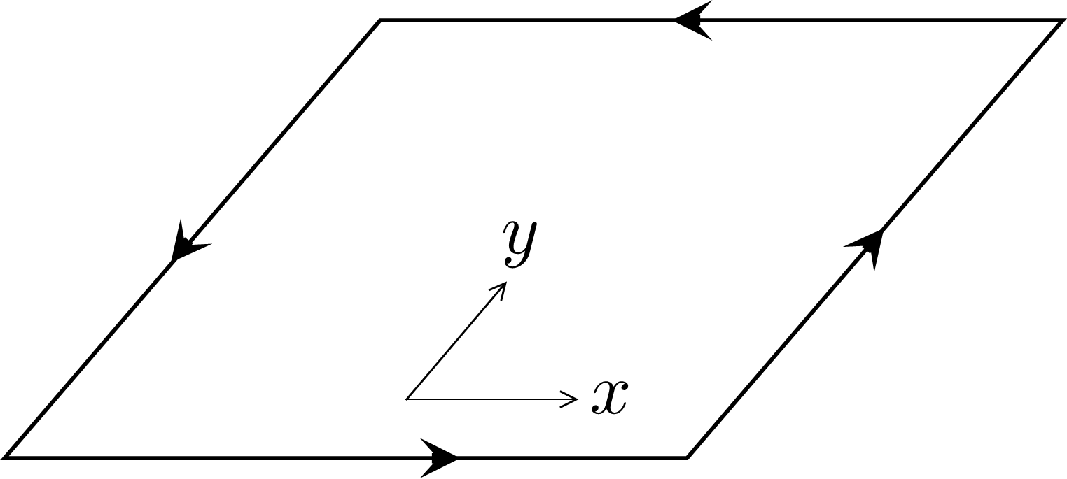
Gapless Bulk + Edges With Disorder
Edge-bulk competition
Depends on the symmetry class

Slide 11
Gapless Bulk + Edges With Disorder
Case I:
AQH, C=1
localizes
trivial

Slide 12
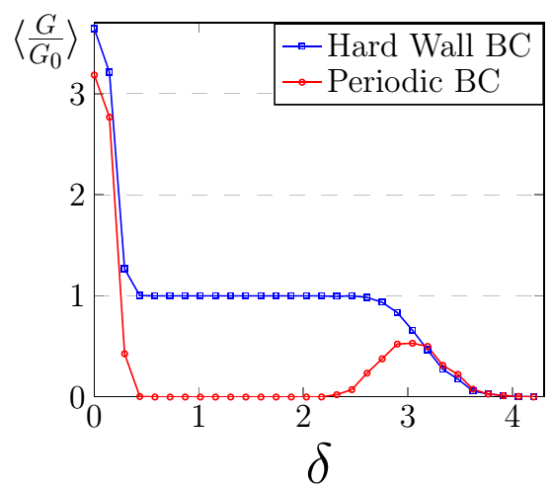
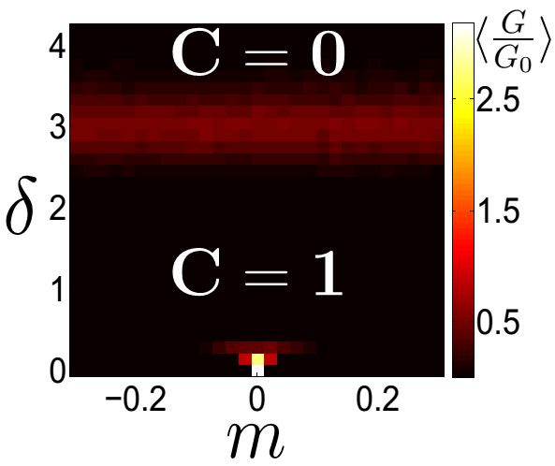
Gapless Bulk + Edges With Disorder
Case I: Edges Win

Slide 13
Gapless Bulk + Edges With Disorder
Case II:
The edge wins – force to localize.
doesn’t localize by itself.

Slide 14
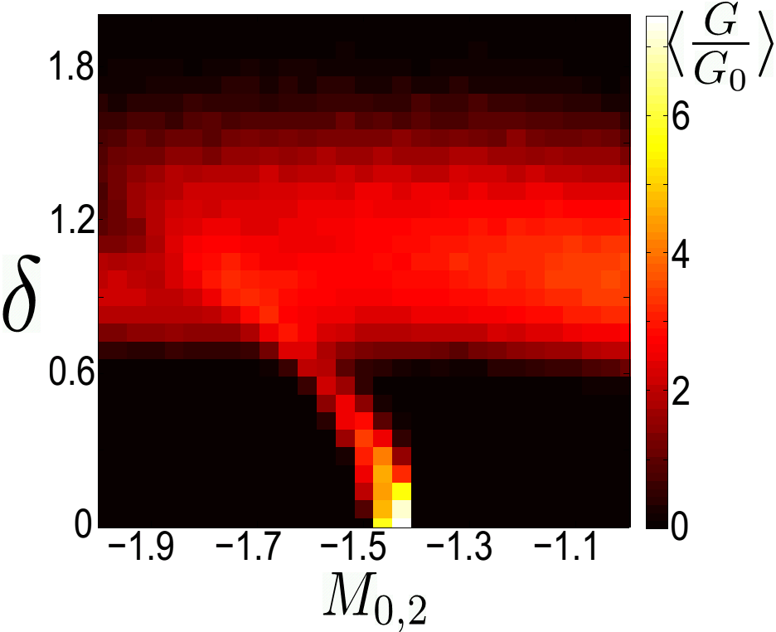
Gapless Bulk + Edges With Disorder
Case III:
Bulk Wins:

Slide 15
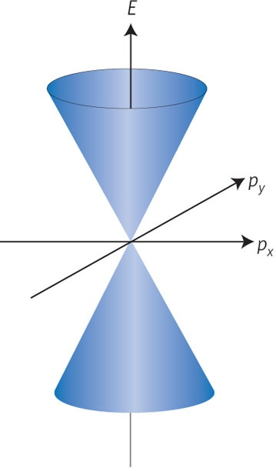
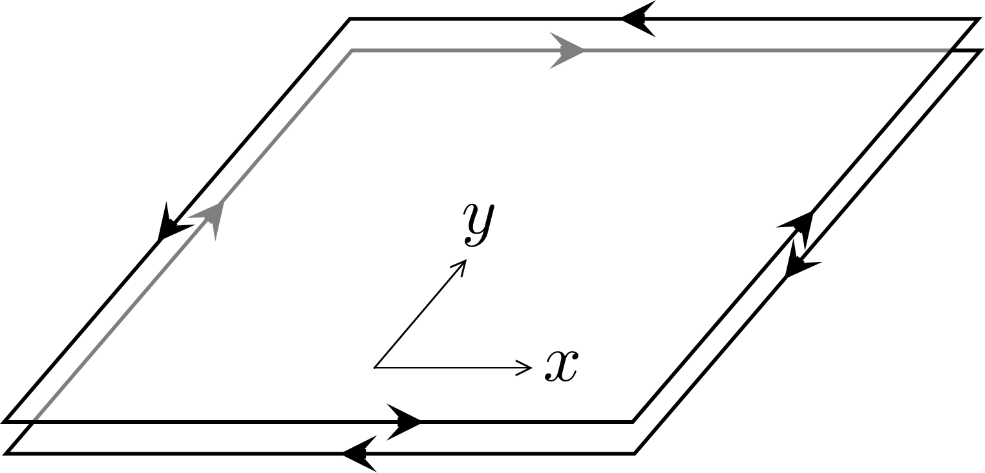
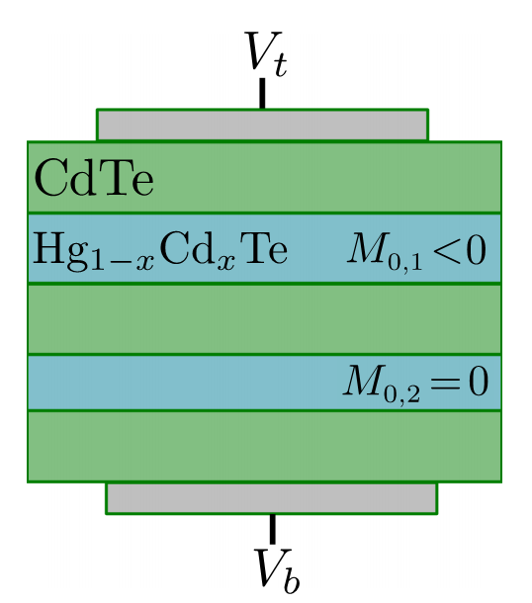
Gapless bulk + Edges
In experiment:
QSHE
QSHE

Slide 16
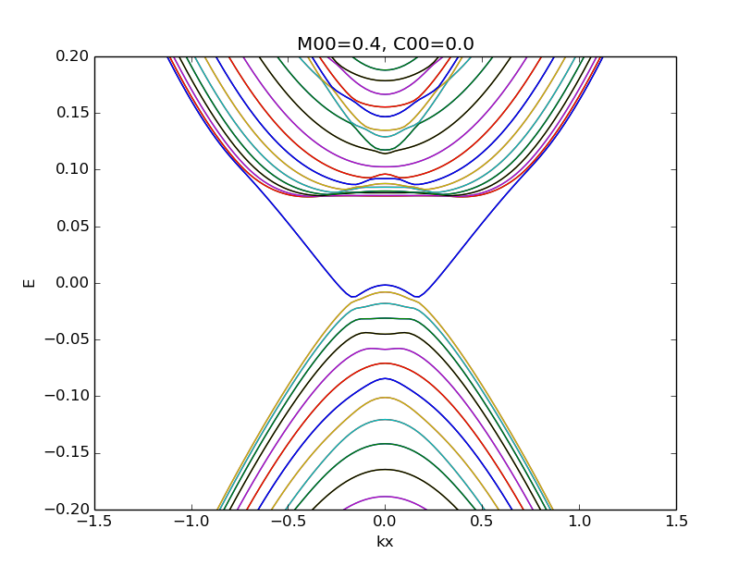
Gapless bulk + Edges
In experiment:
QSHE
QSHE

Slide 17
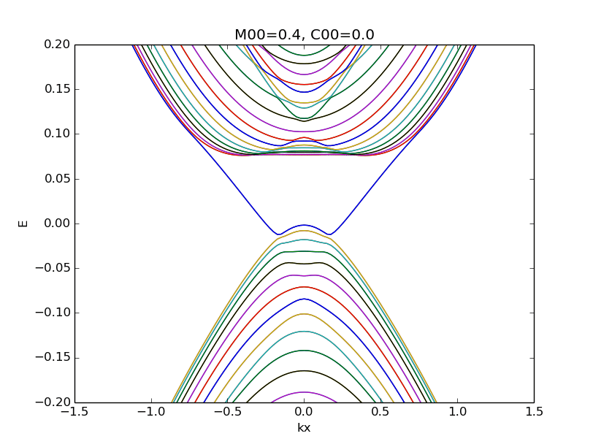
Gapless bulk + Edges
In experiment:
QSHE
QSHE

Slide 18
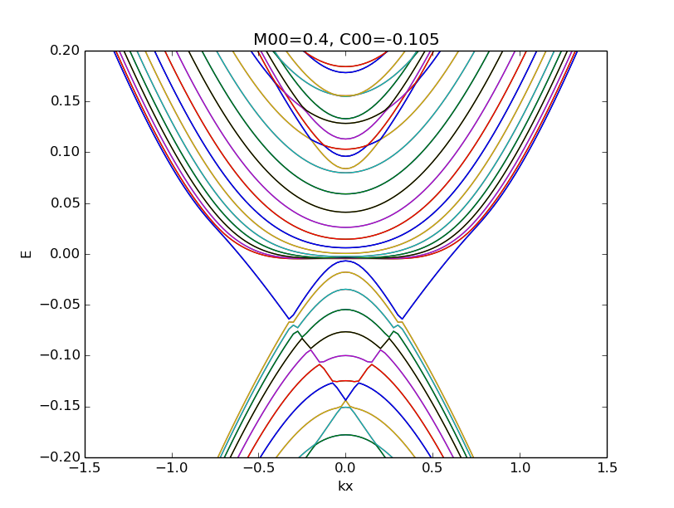
Gapless bulk + Edges
In experiment:
QSHE
QSHE

Slide 19
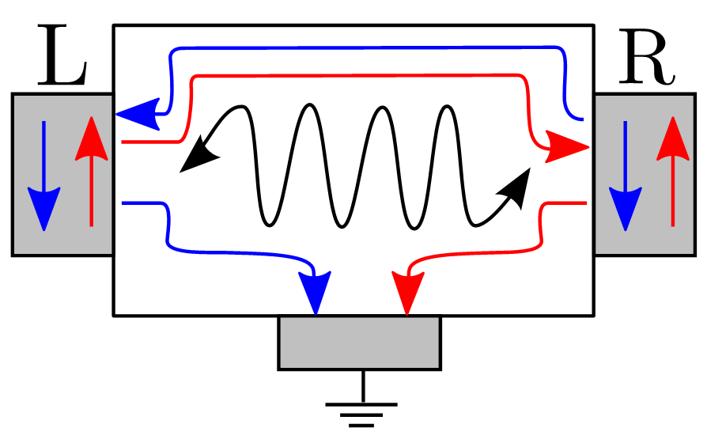
Gapless bulk + Edges
In experiment:

Slide 20
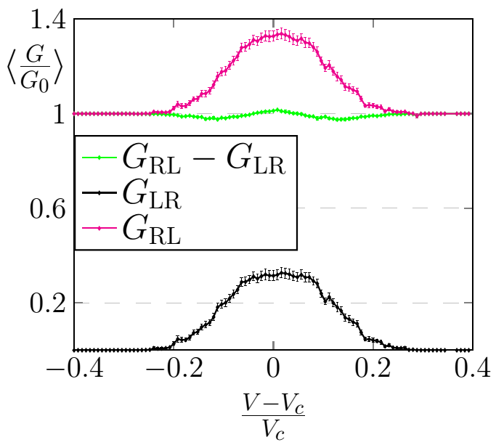
Gapless bulk + Edges
In experiment:

Slide 21
Conclusions
Gapless Bulk and Edge modes coexist
“Weak” and “Strong” edges
Different behavior with disorder
Double Hg(Cd)Te quantum wells

