Slide 1
Status of TI Materials

Slide 2


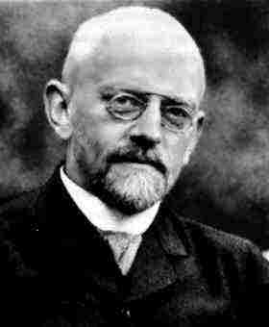
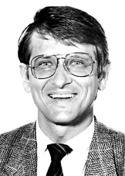
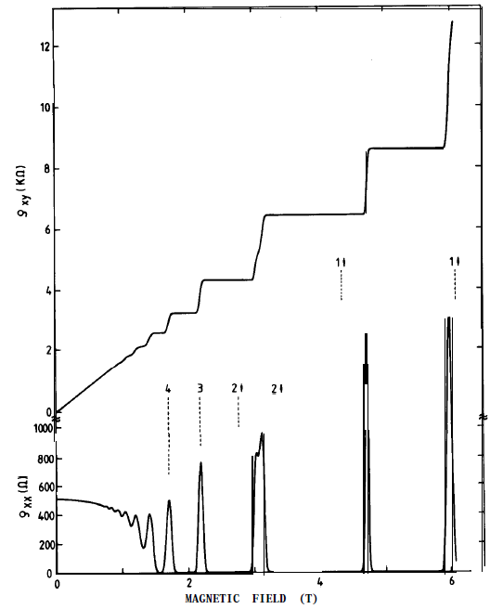
Topology & Topological Invariant
Not continuously deformable
Topological
Invariant
Number of Holes
“Nontrivial”
topology
Manifold of wave functions in the Hilbert space
Quantum Hall system:
D. Hilbert
ρ_{xy}
Bulk acquires a
Landau-Level gap
H
ρ_{xx}
K. von Klitzing

Slide 3
Topological Insulators
k_{y}
k_{y}
Brillouin zone
Im u_{n}
Complex
plane
Λ₃
Λ₄
π
+
+
w.f. parity at Λ_{i} :
ξ (Λ_{i})
Λ₁
Λ₂
u_{n}(k)
-
−π
π
0
π
+
0
k_{x}
0
Re u_{n}
k_{x}
Chern number: n
Z₂ invariant: ν (= 0 or 1)
Magnetic Field
ν = 1
Bulk Conduction Band
n = 2
down
spin
up spin
Energy
Dirac point
Bulk Valence Band
Quantum Hall System
2D Topological Insulator
k = 0
k

Slide 4
Topological Insulators
k_{y}
k_{y}
Brillouin zone
Im u_{n}
Complex
plane
Λ₃
Λ₄
π
+
+
w.f. parity at Λ_{i} :
ξ (Λ_{i})
Λ₁
Λ₂
u_{n}(k)
-
−π
π
0
π
+
0
k_{x}
0
Re u_{n}
k_{x}
Chern number: n
Z₂ invariant: ν (= 0 or 1)
Magnetic Field
E
2D Dirac cone
n = 2
Helical spin
polarization
Quantum Hall System
3D Topological Insulator

Slide 5
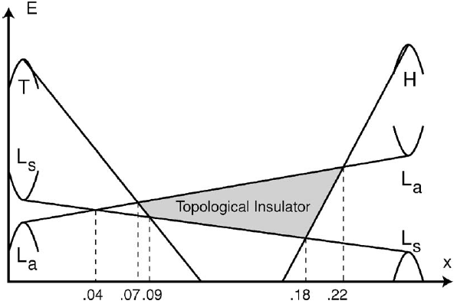
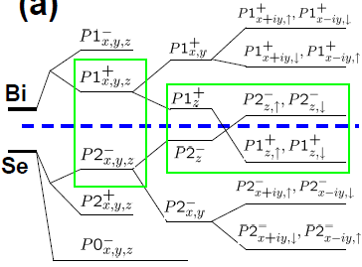
3D Topological-Insulator Materials
Bi_{1-x}Sb_{x}
Bi₂Se₃
Fu & Kane, PRB (2007)
Band Inversion
Zhang et al.,
Nat. Phys.
(2009)
Bonding
CF
SOC
Hsieh et al., Nature (2008)
x = 0.10
BCB
Xia et al.,
Nat. Phys.
(2009)
BVB

Slide 6
Bi₂Se₃
Stanford-NHMFL Collaboration
Sb-doped Bi₂Se₃
E_{F}
BCB
Analytis et al., Nature Physics (2010)
Surface contribution ~0.1%
BVB

Slide 7
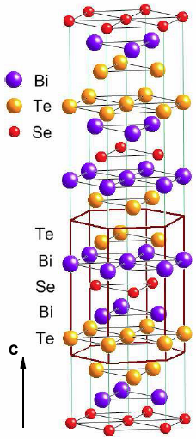
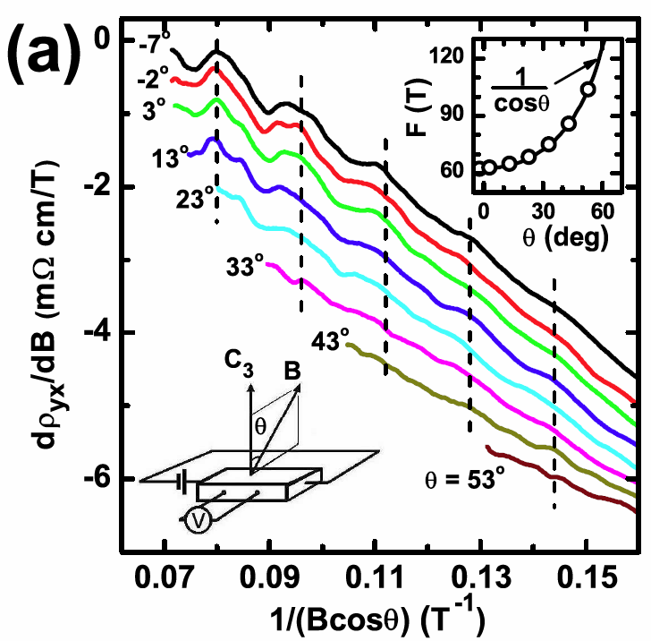
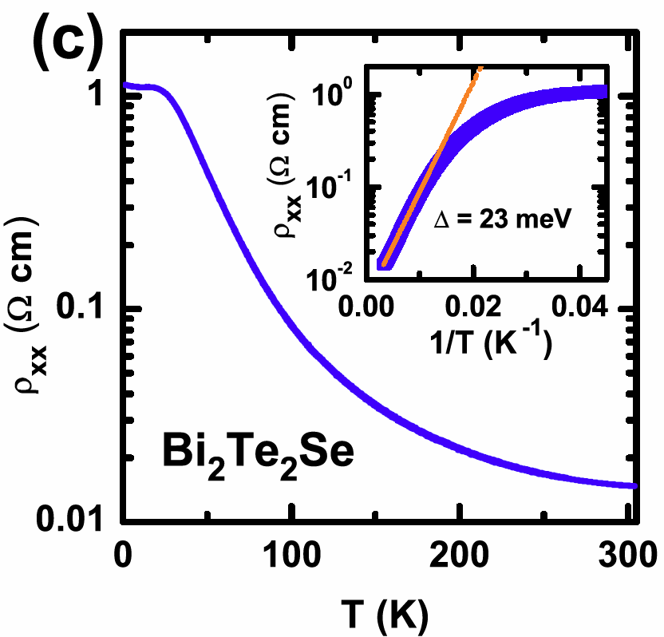
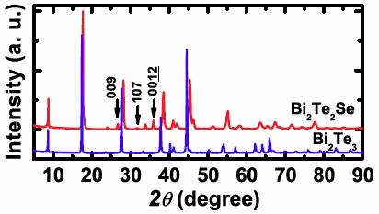
Important Theme in TI Research：
How to reduce bulk carriers and
achieve a bulk-insulating state
Bi₂Te₂Se
Nominally stoichiometric
crystals of Bi₂Se₃ : n-type
Bi₂Te₃ : p-type
Activation behavior above 150 K with
Δ = 23 meV
θ-dependence signifies that the Fermi surface is 2D.
Chalcogen ordering leads to characteristic peaks .
Surface contribution is ~6% !
Ren, Ando et al., PRB (2010)

Slide 8
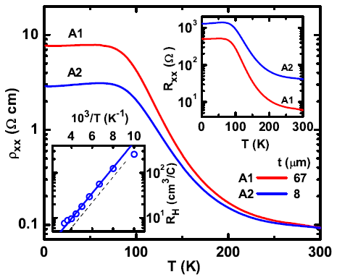
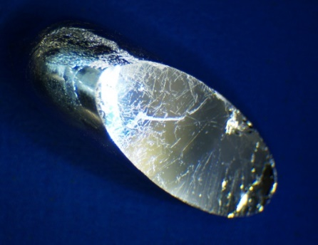
Bi_{2-x}Sb_{x}Te_{3-y}Se_{y}
Bi_{1.5}Sb_{0.5}Te_{1.7}Se_{1.3}
Thickness Dependence
In the 8-μm-thick sample,
the surface contribution is 70%!
Surface-Dominated Transport
Ren, Ando et al., PRB (2011)
Taskin, Ando et al., PRL (2011)

Slide 9
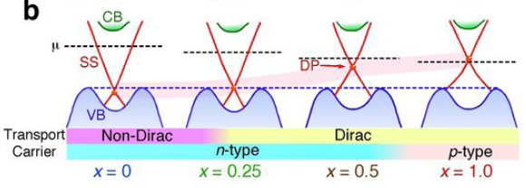
ARPES on Bi_{2-x}Sb_{x}Te_{3-y}Se_{y}
y
Arakane, Sato, Ando et al.,
Nature Commun. (2012)

Slide 10
Spin Pumping
Spin-Electricity Conversion from
Spin-Momentum Locking
Symmetrical signal is due to bulk Seebeck effect caused by heating.
Shiomi, Saitoh, Ando et al., PRL (2014)

Slide 11
BSTS Spin-MR Device (Kyoto)
+I
-I
Bi₂Se₃
Ando, Shiraishi, Ando et al., Nano Lett. (2014)

Slide 12
Bi₂Se₃ Thin Films

Slide 13
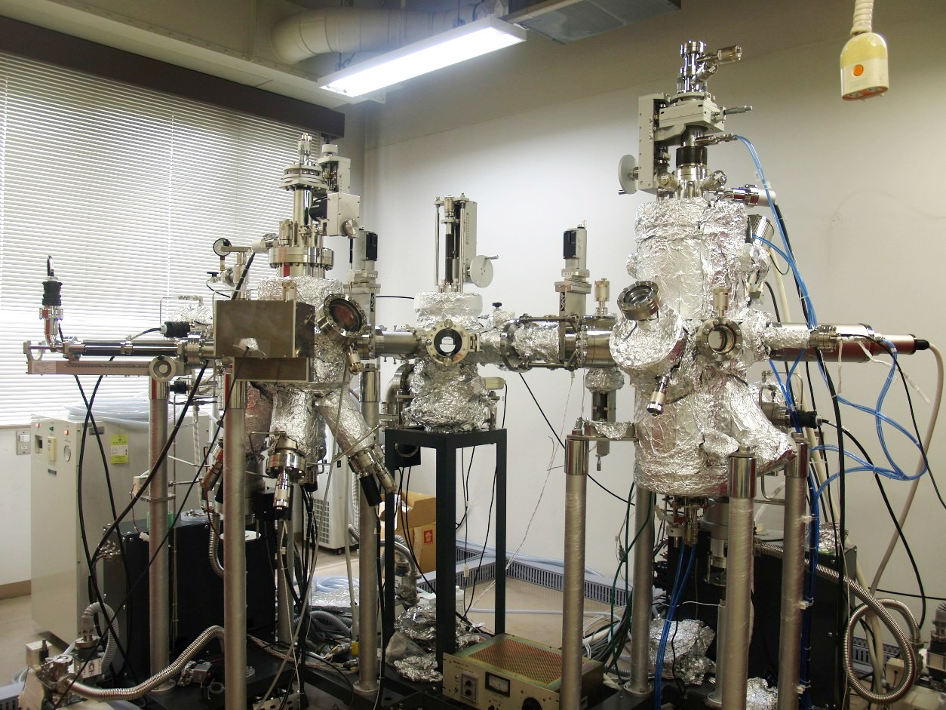
Taskin, Ando et al., Adv. Mater. (2012)
40-nm thick film
Bi₂Se₃

Slide 14
MBE-Grown Bi₂Se₃ Fimls
10-nm thick Film
50-nm thick film
Dirac
2D
graphite
graphene

Slide 15
Surface Morphology Across t_{c}
3-nm Film
5-nm Film
8-nm Film
Taskin, Ando et al., PRL (2012)

Slide 16
Topological Protection
Bulk Conduction Band
down
spin
up spin
E_{F}
Hybridization of top and bottom surfaces
Energy
Dirac point
Top surface
Top surface
Bulk Valence Band
Protection from
backscattering
k = 0
k
Bottom surface
hybridize
E_{F}
Bottom surface
Surface states become degenerate.
→ No protection from backscattering.
Y. Zhang, Q.K. Xue et al., Nat. Phys. (2010)

Slide 17
Topological Protection
Bulk Conduction Band
down
spin
up spin
E_{F}
Hybridization of top and bottom surfaces
Energy
Dirac point
Top surface
Top surface
Bulk Valence Band
Protection from
backscattering
k = 0
k
Bottom surface
hybridize
E_{F}
Bottom surface
Surface states become degenerate.
→ No protection from backscattering.
Manifestation of the “topological protection”
Taskin, Ando et al., PRL (2012)

Slide 18
(Bi_{1-x}Sb_{x})₂Te₃ Thin Films
Zhang et al., Nat. Commun. (2011)

Slide 19
Top-Gate Device
Bi_{2-x}Sb_{x}Te₃ Thin Film (30-nm thick)
in situ capped with ~5-nm Al₂O₃
(Dielectric layer: 200-nm SiN_{x})
Yang, Ando et al., APL (2014)

Slide 20
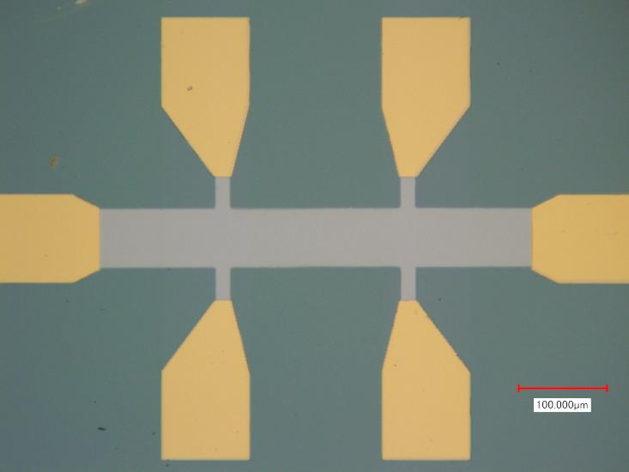
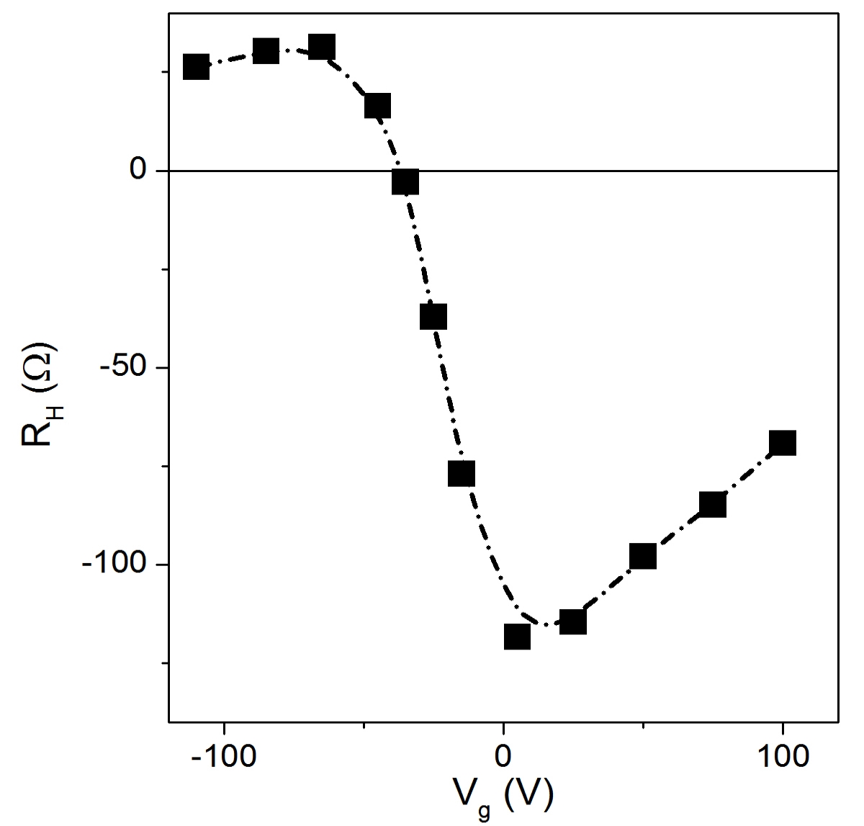
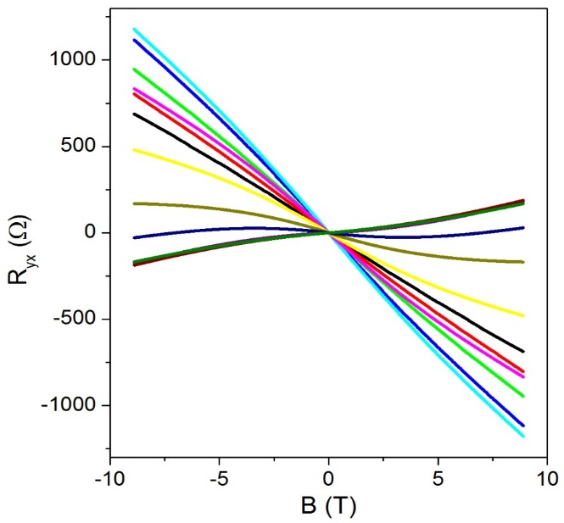
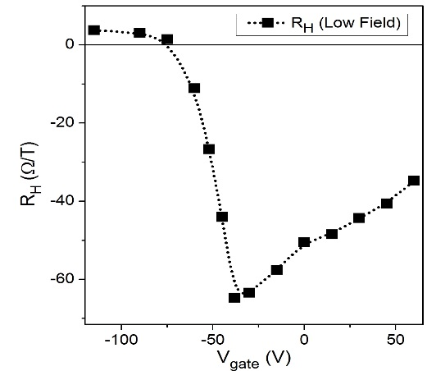
Bottom-Gate Device
Bottom
Top
μ
Bi_{2-x}Sb_{x}Te₃ Thin Film (~20-nm thick)
150-nm SiO₂
Dielectric layer
Top Gate
μ
Bottom
Top

Slide 21

Dual-Gate Device
Bottom
Top
μ
Bi_{2-x}Sb_{x}Te₃ Thin Film (~20-nm thick)
Dual Gate
Top Gate
Bottom
Gate
Yang, Ando et al.,
ACS Nano (2015)

Slide 22
Topological Crystalline Insulator
… New Type of TI

Slide 23

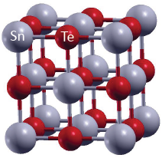
Topological Crystalline Insulator SnTe
: contribution from Te p-orbital
Band inversion + Mirror symmetry
→ Nontrivial Mirror Chern number
SnTe
PbTe
Tanaka, Sato, Ando et al.,
Nature Physics (2012)
k_{y}
Λ₃
Λ₄
-
π
+
SnTe
Λ₁
-
Λ₂
+
π
0
k_{x}
Z₂ invariant ν = 0
PbTe
SnTe
Hsieh et al., Nature Commun. (2012)

Slide 24
SnTe (111) Surface State
Tanaka, Sato, Ando et al., PRB (2013)

Slide 25
SnTe (111) Surface State
Two Different Dirac Cones at Γ and M
Tanaka, Sato, Ando et al., PRB (2013)

Slide 26
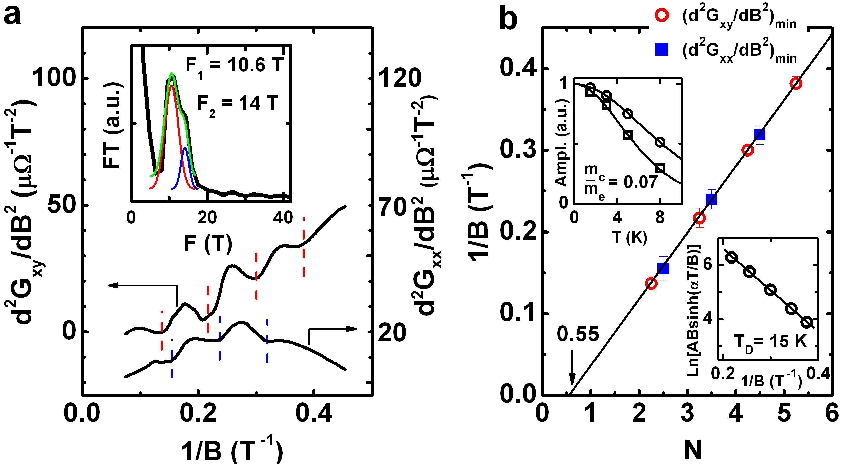
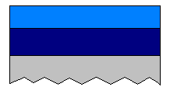
SdH Oscillations in SnTe (111) Films
n-type carriers
Dirac
2D
0.55
SnTe surface
p⁺⁺-SnTe 36 nm
n⁺⁺-Bi₂Te₃ 30 nm
Sapphire
Taskin, Ando et al.,
PRB (2014)

Slide 27
SdH Oscillations in SnTe (111) Films
n-type carriers
Dirac
2D
0.55
k_{F} = 1.8 ×10⁶ cm⁻¹
& 2.1 ×10⁶ cm⁻¹
Dirac fermions on the top SnTe surface
Taskin, Ando et al.,
PRB (2014)

Slide 28
Topological Superconductor

Slide 29
Possible Topological Superconductors
“Periodic Table” of topological invariant
SC in TI surface
Chiral p-wave
Schnyder-Ryu-Furusaki-Ludwig (2008)
Kitaev (2009)
1D
2D
3D
Time-Reversal Broken (TRB)
Z₂
Z
-
(D)
Time-Reversal Invariant (TRI)
Z₂
Z₂
Z
(DIII)
Surface State of TIs
φ = π
φ = 0
Bogoliubov qp
SC
SC
E_{F}
2Δ
E_{F}
Majorana
Edge State
TI
Fu & Kane (2008)
Sr₂RuO₄

Slide 30
2012
Nb
Bi₂Te₃
n-type, 8×10¹⁹ cm⁻³
Clean limit → evidence for surface?

Slide 31
Bi₂Se₃
, n-type, 8×10¹⁷ cm⁻³
I_{c}R_{N} is ~10 times smaller than expected
I_{c}R_{N} scales inversely with W
B_{c} (1st minimum) is ~5 times smaller than expected

Slide 32
2013
Φ/Φ₀ ~ 0.23 n
Flux focusing?
Finite supercurrent through surface state
14-nm-thick (Bi,Sb)₂Se₃
TCNQ surface doping
Back-gating
Ti(2.5 nm)/Al(140 nm)

Slide 33
Small I_{c}R_{N} is explicable if the surface channel dictates R_{N}
T-dep. of I_{c} gives evidence for ballistic junction through the surface state

Slide 34
Bi₂Se₃, n-type
9-nm thick
n_{2D}=10¹³-10¹⁴ cm⁻²
Back gating
L = 230 nm
Andreev reflection
Phase-coherent transport in TI
→ Due to topological protection of the surface state?
Fabry-Perot oscillations
ZBCP similar to that in 1D SOC nanowire
(weak antilocalization?)

Slide 35
Bulk-insulating BSTS flake, 80 – 200 nm thick
Junction width and length: ~50 nm
I_{c}R_{N} is only 7 μV ←
Mean free path: 10 – 40 nm
Low transparency
Diffusive transport through surface

Slide 36
Zero-bias anomaly → induced SC?
No supercurrent in this experiment
Precursor to Fraunhofer pattern?
50 or 70 nm-thick HgTe → 3D TI
Sample with improved interface
Δ_{Nb} = 1 meV, Andreev reflection

Slide 37
70 nm-thick
HgTe as 3D TI
fluctuations originate from Josephson effect
Supercurrent through the surface state
Only 2π periodicity
No signature of Majoranas, which is reasonable for a large number of unprotected modes

Slide 38
No inverse proximity effect
→ Absence of bulk states
Skewness (due to the 2nd harmonic) remains the same for varying W and L
Fits very well to ballistic junction model
→ Josephson current is carried by ABS with high transmittance, which is possibly related to the helical nature of the surface state

Slide 39
2D TI

Slide 40
2D TI, 7.5-nm HgTe
W = 4 μm
L = 800 nm
μ in the bulk CB
μ in the bulk gap
Evidence for supercurrents through the 1D helical edge state
Similar result for InAs/GaSb
arXiv:1408.1701

Slide 41
Ferromagnetic Atomic Chain

Slide 42
FM chain
+ Rashba SOC in s-wave SC
SC Tip (high resolution)
→ p-wave gap ~ 0.3 meV
Fe chain on Pb(110)
Spin-polarized STM
Odd number of crossings

