Slide 1


Majorana Fermions in
Topological Superconductors
Basic Concept and Exotic Properties
Physical Realizations
Majorana Takes Charge
Towards Quantum Computation
Liang Fu
2015 Capri School

Slide 2
Zero-Bias Conductance Peak
Encouraging Hints of Majorana
Kouwenhoven’s group

Slide 3
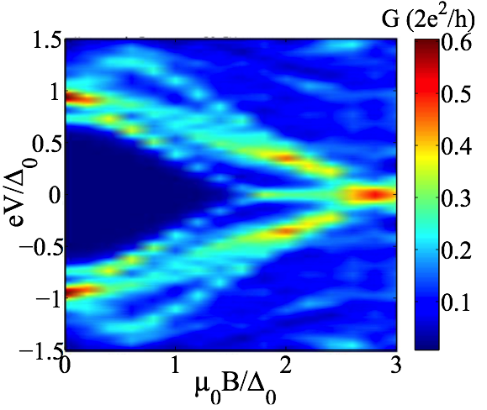
Zero-Bias Conductance Peak
Generic ZBCP under disorder
Liu, Potter, Law, Lee
Kouwenhoven’s group
More evidence is needed:
bulk proximity gap and gap-closing, quantization of ZBCP at low T.
* tunneling into Majorana mode does not probe topological qubit, but destroys it.

Slide 4
Potter & LF, PRB 13

Slide 12


Slide 18
Υ₁ => Υ₂ , Υ₂ => -Υ₁
Braiding operation:
Ivanov (01)

Slide 21
(Yacoby’s group 14)

Slide 22
Engineering Topological Superconductivity: Finding Majorana
LF, Kane (08, 09)
Key idea: a spin non-degenerate Fermi surface under proximity effect

Slide 23
Engineering Topological Superconductivity: Finding Majorana
LF, Kane (08, 09)
Key idea: a spin non-degenerate Fermi surface under proximity effect
topology + superconductivity: time-reversal symmetry ensures happy marriage.

Slide 24
Engineering Topological Superconductivity: Finding Majorana
simulate helical liquid by T breaking + spin-orbit
topological superconductivity requires tuning E_{F}, B field and proximity gap

